Slide 1
HPC networks: Infiniband

Slide 2
IBA
The InfiniBand Architecture (IBA) is an industry-standard architecture for server I/O and inter-server communication.
Developed by InfiniBand Trade Association (IBTA).
It defines a switch-based, point-to-point interconnection network that enables
High-speed
Low-latency
communication between connected devices.

Slide 3
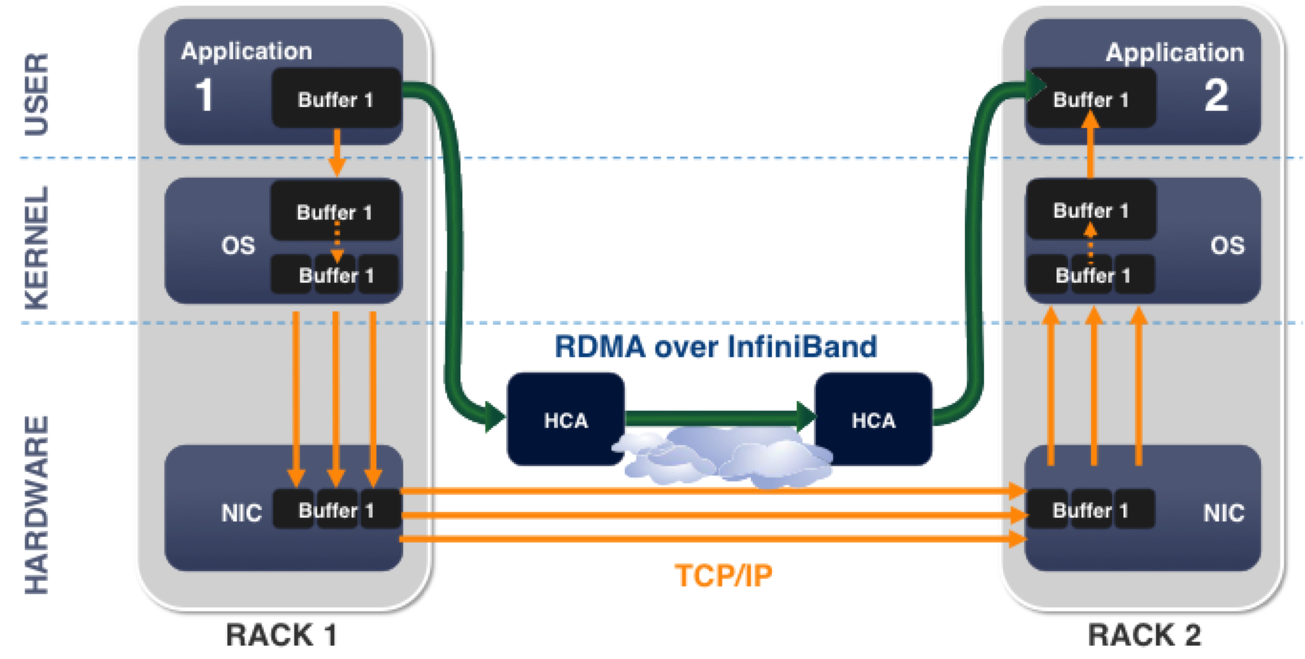
Infiniband used RDMA based Communication

Slide 4
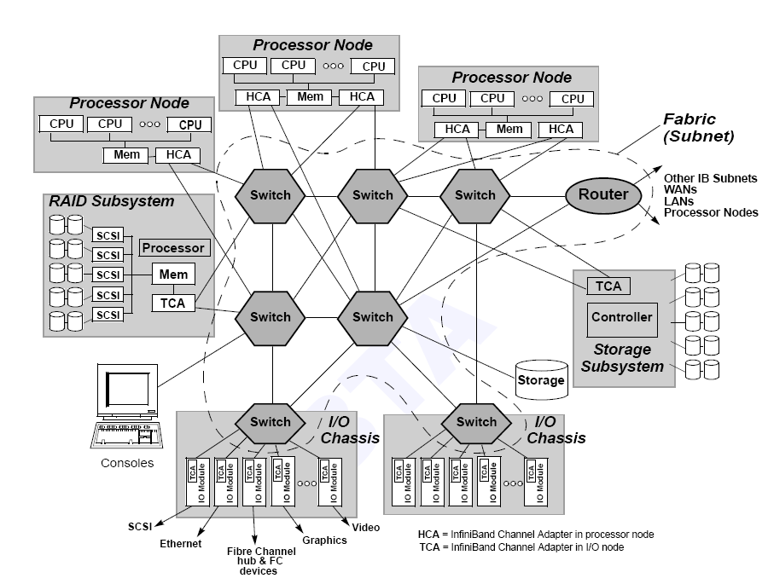
Infiniband architecture overview

Slide 5
Architecture Layers

Slide 6
InfiniBand VS. Ethernet
 | Ethernet | InfiniBand
Commonly used in what kinds of network | Local area network(LAN) or wide area network(WAN) | Interprocess communication (IPC) network
Transmission medium | Copper/optical | Copper/optical
Bandwidth | 1Gb/10Gb | 2.5Gb~120Gb
Latency | High | Low
Popularity | High | Low
Cost | Low | High

Slide 7
InfiniBand Devices

Slide 8
IBA Subnet

Slide 9
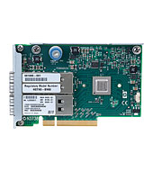
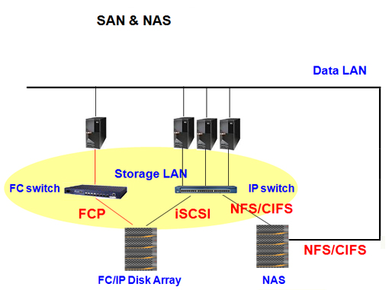
Endnodes
IBA endnodes are the ultimate sources and sinks of communication in IBA.
They may be host systems or devices.
Ex. network adapters, storage subsystems, etc.

Slide 10
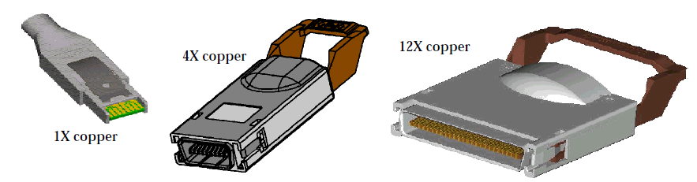
Links
IBA links are bidirectional point-to-point communication channels, and may be either copper and optical fibre.
The base signalling rate on all links is 2.5 Gbaud.
Link widths are 1X, 4X, and 12X.

Slide 11
Channel Adapter
Channel Adapter (CA) is the interface between an endnode and a link
There are two types of channel adapters
Host channel adapter(HCA)
For inter-server communication
Has a collection of features that are defined to be available to host programs, defined by verbs
Target channel adapter(TCA)
For server IO communication
No defined software interface

Slide 12
Addressing
LIDs
Local Identifiers, 16 bits
Used within a subnet by switch for routing
Dynamically assigned at runtime
GUIDs
Global Unique Identifier
Assigned by vendor (just like a MAC address)
64 EUI-64 IEEE-defined identifiers for elements in a subnet
GIDs
Global IDs, 128 bits (same format as IPv6)
Used for routing across subnets

Slide 13
GID: Routing across subnets

Slide 14
Switches
IBA switches route messages from their source to their destination based on routing tables
Configured explicitly by Subnet Manager
Switch size denotes the number of ports
The maximum switch size supported is one with 256 ports
The addressing used by switched
Local Identifiers, or LIDs allows 48K endnodes on a single subnet
A 64K LID address space is reserved for multicast addresses
Routing between different subnets is done on the basis of a Global Identifier (GID) that is 128 bits long

Slide 15
Management Basics

Slide 16
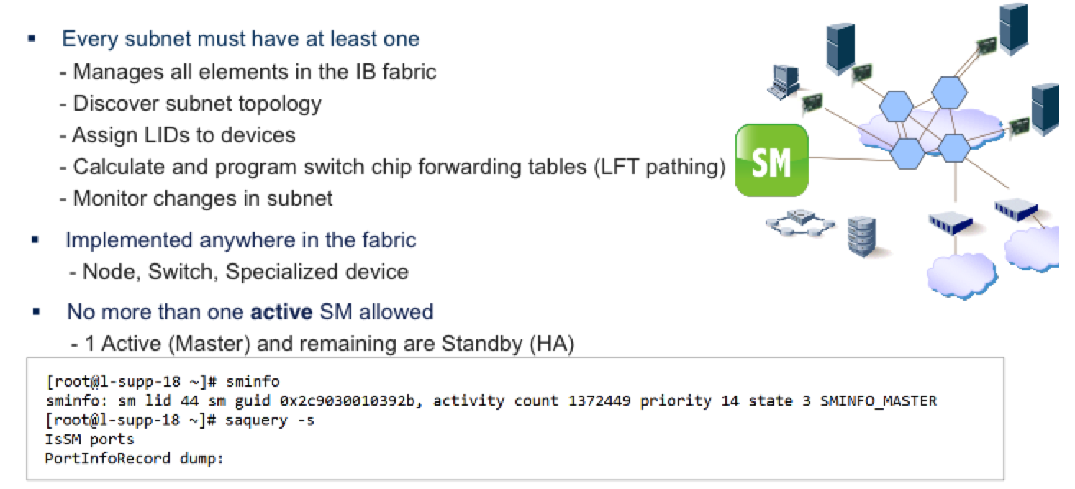
Subnet Manager

Slide 17
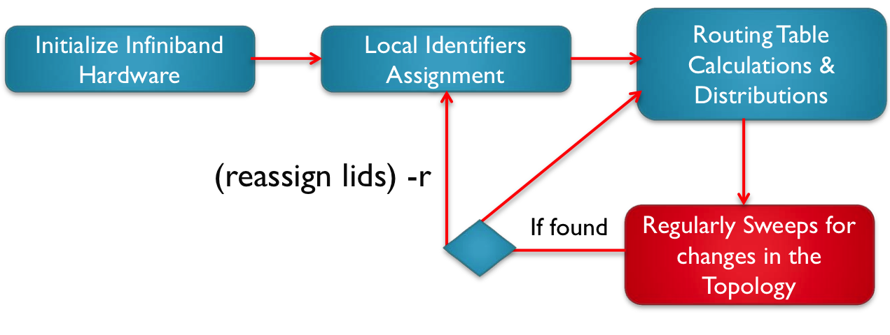
Subnet Management
Subnet Manager:
External software service running on an endhost or switch
OpenSM – most commonly used
Assigns Addresses to endhosts and switches
Directly configures routing tables in each switch and device

Slide 18
Management Datagrams
All management is performed in-band, using Management Datagrams (MADs).
MADs are unreliable datagrams with 256 bytes of data (minimum MTU).
Subnet Management Packets (SMP) is special MADs for subnet management.
Only packets allowed on virtual lane 15 (VL15).
Always sent and receive on Queue Pair 0 of each port

Slide 19
Infiniband routing

Slide 20
Infiniband Routing

Slide 21
Infiniband Packet Format
BTH: Base Transport Header
Processed by endnodes
ICRC: Invariant CRC
CRC over fields that don’t change
VCRC: Variant CRC
CRC over fields that can change
GRH: Global Routing Header
Routes between subnets

Slide 22
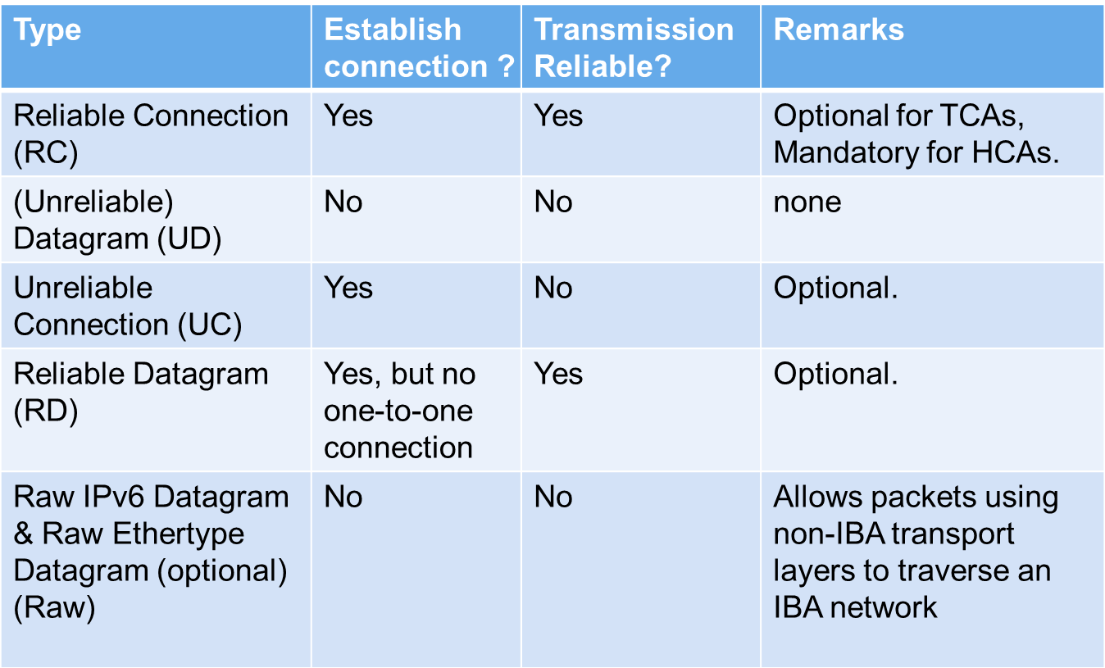
Communication Service Types

Slide 23
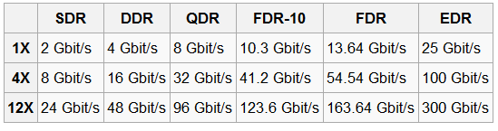
Data Rate
Effective theoretical throughput

Slide 24
Queue-Based Model
Channel adapters communicate using Work Queues of three types:
Queue Pair(QP) consists of
Send queue
Receive queue
Work Queue Request (WQR) contains the communication instruction
It would be submitted to QP.
Completion Queues (CQs) use Completion Queue Entries (CQEs) to report the completion of the communication

Slide 25
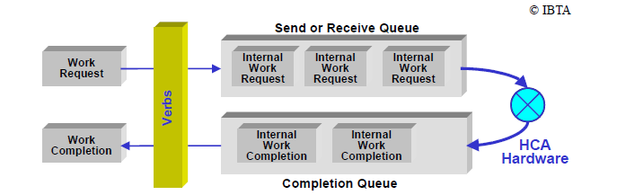
Queue-Based Mode

Slide 26
Access Model for InfiniBand
Privileged Access
OS involved
Resource management and memory management
Open HCA, create queue-pairs, register memory, etc.
Direct Access
Can be done directly in user space (OS-bypass)
Queue-pair access
Post send/receive/RDMA descriptors.
CQ polling

Slide 27
Access Model for InfiniBand
Queue pair access has two phases
Initialization (privileged access)
Map doorbell page (User Access Region)
Allocate and register QP buffers
Create QP
Communication (direct access)
Put WQR in QP buffer.
Write to doorbell page.
Notify channel adapter to work

Slide 28
Access Model for InfiniBand
CQ Polling has two phases
Initialization (privileged access)
Allocate and register CQ buffer
Create CQ
Communication steps (direct access)
Poll on CQ buffer for new completion entry

Slide 29
Memory Model
Control of memory access by and through an HCA is provided by three objects
Memory regions
Provide the basic mapping required to operate with virtual address
Have R_key for remote HCA to access system memory and L_key for local HCA to access local memory.
Memory windows
Specify a contiguous virtual memory segment with byte granularity
Protection domains
Attach QPs to memory regions and windows

Slide 30
InfiniBand creates a channel directly connecting an application in its virtual address space to an application in another virtual address space.
The two applications can be in disjoint physical address spaces – hosted by different servers.

Slide 31
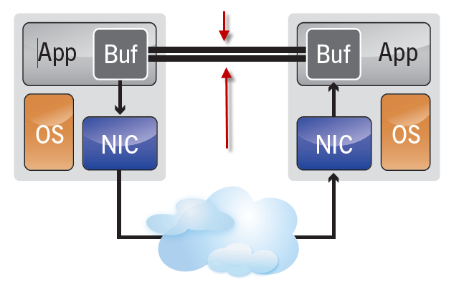
Communication Semantics
Two types of communication semantics
Channel semantics
With traditional send/receive operations.
Memory semantics
With RDMA operations.

Slide 32
Send and Receive
Process
Remote Process
WQE
CQ
CQ
QP
QP
Transport Engine
Transport Engine
Send Recv
Send Recv
Channel
Adapter
Channel
Adapter
Port
Port
Fabric

Slide 33
Send and Receive
Process
Remote Process
WQE
CQ
CQ
QP
QP
Transport Engine
Transport Engine
WQE
Send Recv
Send Recv
Channel
Adapter
Channel
Adapter
Port
Port
Fabric

Slide 34
Send and Receive
Process
Remote Process
CQ
CQ
QP
QP
Transport Engine
Transport Engine
WQE
WQE
Send Recv
Send Recv
Data packet
Channel
Adapter
Channel
Adapter
Port
Port
Fabric

Slide 35
Send and Receive
Complete
Process
Remote Process
CQ
CQ
QP
CQE
QP
CQE
Transport Engine
Transport Engine
Send Recv
Send Recv
Channel
Adapter
Channel
Adapter
Port
Port
Fabric

Slide 36
RDMA Read / Write
Process
Remote Process
Target Buffer
CQ
CQ
QP
QP
Transport Engine
Transport Engine
Send Recv
Send Recv
Channel
Adapter
Channel
Adapter
Port
Port
Fabric

Slide 37
RDMA Read / Write
Process
Remote Process
Target Buffer
WQE
CQ
CQ
QP
QP
Transport Engine
Transport Engine
Send Recv
Send Recv
Channel
Adapter
Channel
Adapter
Port
Port
Fabric

Slide 38
RDMA Read / Write
Process
Remote Process
Target Buffer
Read / Write
CQ
CQ
QP
QP
Transport Engine
Transport Engine
WQE
Send Recv
Send Recv
Data packet
Channel
Adapter
Channel
Adapter
Port
Port
Fabric

Slide 39
RDMA Read / Write
Complete
Process
Remote Process
Target Buffer
CQ
CQ
QP
CQE
QP
Transport Engine
Transport Engine
Send Recv
Send Recv
Channel
Adapter
Channel
Adapter
Port
Port
Fabric

